Slide 1
Centric EDW 2.0 Architecture

Slide 2
Architecture
Data Lake / Staging
CDM
Reference
Audit
Dedicated Schema Per BI Tool
Master Data Without a Source
Managed of Load Processes
CUBE
TABLEAU
Source Staging
Database
VER
VEX
DBO
DBO
MSTR
Warehouse
Mart
Source Staging
Database
Single Version of Operational Facts
Managed Versions of Analytics Structures
Source Data
Structures + Augmentation

Slide 3
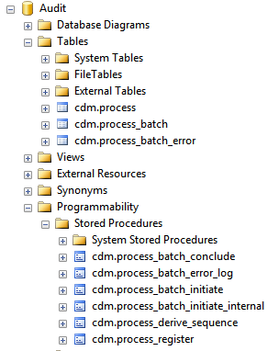
Auditing
Maintained in dedicated schema
Integrated into ETL Event Handlers
Captures each package execution
Manages incremental load values
Enables CDC capability through Batch Keys
Tags each record (Staging > EDW)

Slide 4
Staging
Data Model
Processing
Guiding Principles
Truncate / Load
SSIS Package Template
Dedicated staging database per source
Replicate source structure and columns
Replicate source schemas
Multi-instance combined with added instance column
Batch Key for CDC
May include custom tables augmenting translation of source data.
TWO PATTERNS
Streaming Log
SSIS Package
Template

Slide 5
EDW
Generated from metadata
Data Model
Processing
Guiding Principles
Schema denotes versioning function
Database objects all generated from metadata
Column names carry classes and standard data types
Boilerplate columns (Source and Version)
VER tables clustered on grain columns.
VEX tables joined 1:1 on version key
VEX tables carry filtered index on VERSION_LATEST_IND
DBO Views are pattern-based, simple and highly efficient. Follow VER structure.
VER Version
SSIS Package Template
SINGLE PATTERN
VEX
Version Management
Incremental Settlement Procedure
DBO Current Views

Slide 6
Settlement
Guiding Principles
Processing
VER
VEX
Settle Procedure
For each grain value(s), need to revaluate VEX version order, identify current and latest records
ACTION
Truncate/Load VEX table
TWO PATTERNS
Settle Merge Procedure
ACTION
For each grain that changes in VER
…Consider all version records having that grain
Insert new version records in VEX
Update restated version records in VEX using MERGE statement

Slide 7
EDW Object Generation
Guiding Principles
XML Metadata
Xml holds entities and attributes
Specify classes for each column
Enforces consistency in data model
Ensures consistency in pattern-based procedures and views
EDW Database Objects
+
XSLT Transform

Slide 8
Mart
Data Model
Processing
Guiding Principles
DBO Schema
Tables
SSIS Package Template
Views against Warehouse are still highly efficient due to pattern-based approach
Schemas denote BI function / tool.
DBO Schema supports general query needs, contains all data.
{BI Tool} Schema supports a specific tool and reads from the Mart DBO schema
TWO PATTERNS
{BI Tool} Schema
Views
N/A

Slide 9
Next Steps
Questions? Ask D&A architecture team.
Find bugs? Let us know so we can fix them in the Master solution
New idea? Share with the D&A Community.
Replatform Xslt & ETL patterns on Oracle, MySQL, DB2, PostgreSQL, etc. Send your code!

